Slide 1
The Introduction of SSO(Single sign-on)
Based on spring session + spring security

Slide 2



Why SSO
Monolithic env
Micro-service env
authentication service
micro-service A
micro-service B
access
without login
login
access
without login
login
business logic access
access
without login
micro-service C
???

Slide 3
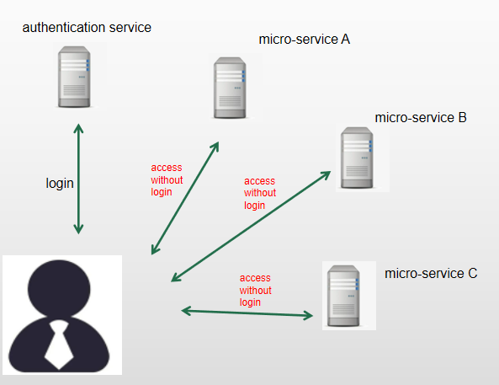
Two key issues
area1
?
Data sharing approch
Authentication and authorization work independently
area2
Data sharing approches
- JWT
- Spring Session
- Spring Session
Authentication and authorization work independently
- Spring Security

Slide 4
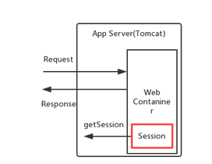
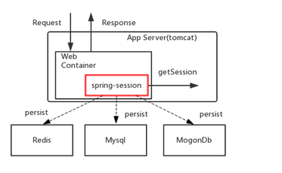
Spring Session
traditional web session
spring session

Slide 5
Spring Security
AuthenticationManager authenticates username&password, and returns an authentication object if username&password are matched
Put the authentication object into SecurityContext
AccessDecisionManager decides if user has the permission to access to the protected resources based on the authentication object stored in SecurityContext

Slide 6
The key idea of SSO
In the authentication service, do the authentication, then store authentication object returned into spring session
In the business services, get authentication object from spring session, put it into Security Context, then do authorization

Slide 7
References:
https://spring.io/guides/topicals/spring-security-architecture
https://github.com/hi-supergirl/exercises/tree/master/java/spring/sso

Slide 8
Http request
Http response
Filter-1
Filter-2
Filter-3
...
Filter-n
business logic

Slide 9
Http request
Http response
Filter-1
Filter-2
DelegatingFilterProxy
...
Filter-n
business logic

Slide 10
Http request
Http response
Sub Filter chain1
Filter-1
/api/v1/**
security filter 1
Filter-2
security filter 2
......
security filter x
DelegatingFilterProxy
FilterChainProxy
Sub Filter chain2
...
/api/v2/**
Filter-n
security filter 1
security filter 2
......
security filter y
business logic

Slide 11
AuthenticationManager
ProviderManager
AuthenticationProvider
- List<AuthenticationProvider> providers
- AuthenticationManager parent
DaoAuthenticationProvider

Slide 12
authentication service
user api service
service B
service C
service D

